Slide 1


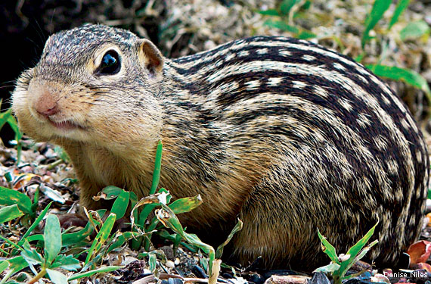
Determination of S- and M-Cone Identity -
Genetic Profiling of Cone Types in the Ground Squirrel Retina
Vincent Kunze, Juan M. Angueyra, Li Jia, Christian Puller, Wei Li
Vincent Kunze
Retinal Neurophysiology (Wei Li)
AG Biochemie (Karl-W. Koch)

Slide 2

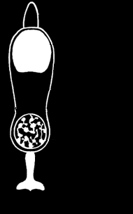


Differences between Photoreceptors Types?
VS.
S-cone M-cone
Rod
Cone
Single Cell RNA Sequencing
Identify uniquely expressed or highly up- or downregulated genes in S-cones compared to M-cones

Slide 3
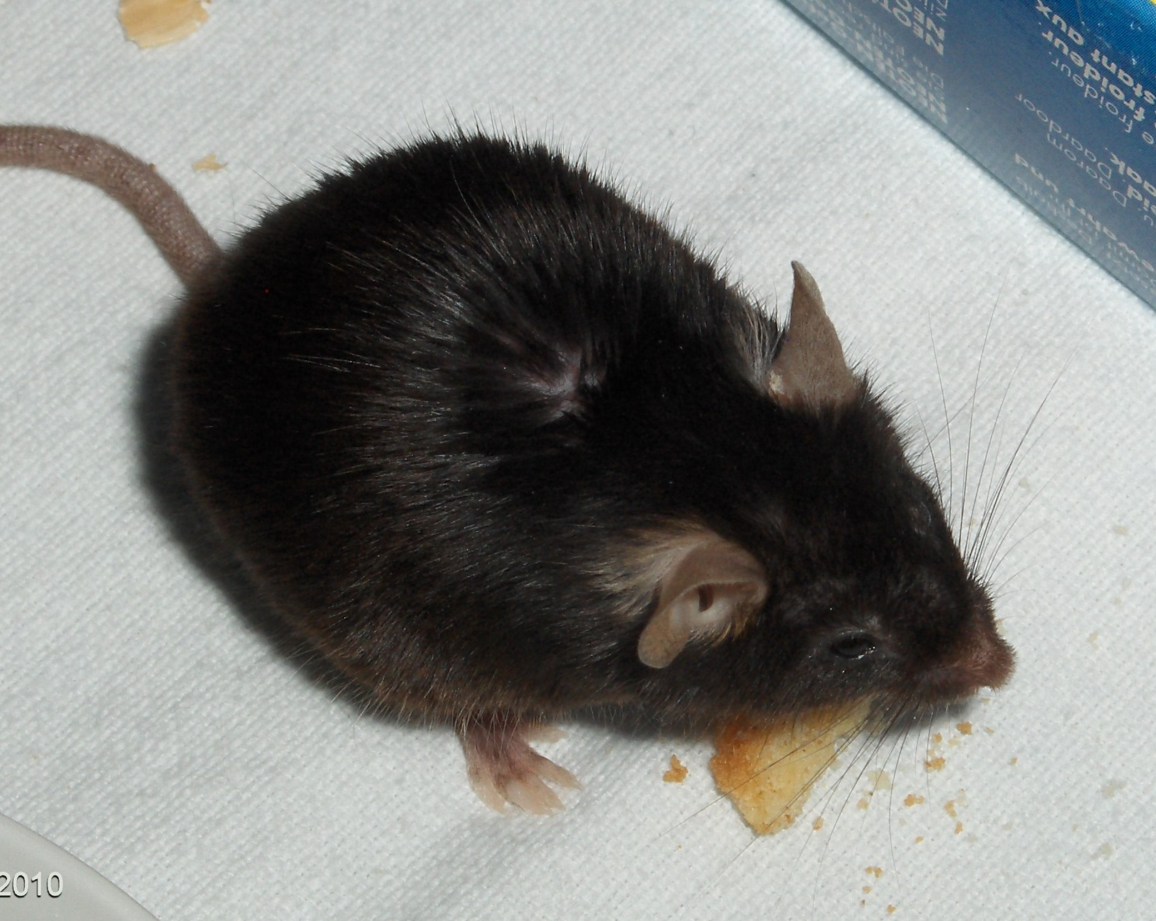
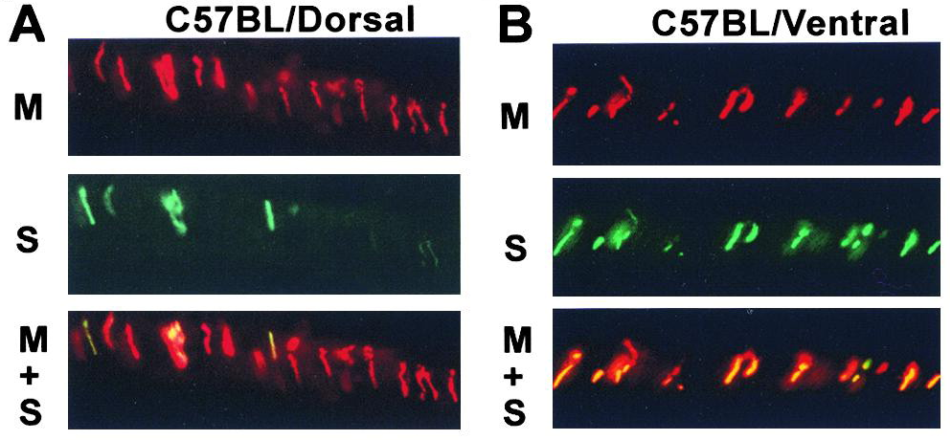
Most Mouse Cones Co-express S- and M-opsin
wikimedia.org
Rod dominated
Majority of Cones express both S- and M-opsin
Applebury et al., 2000

Slide 4
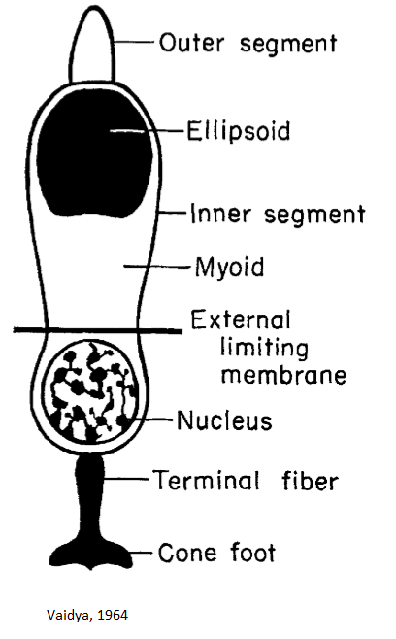
Thirteen-lined Ground Squirrel (Ictidomys tridecemlineatus)
S-Opsin
M-Opsin
Rhodopsin
Cone dominated
Only true S-cones

Slide 5
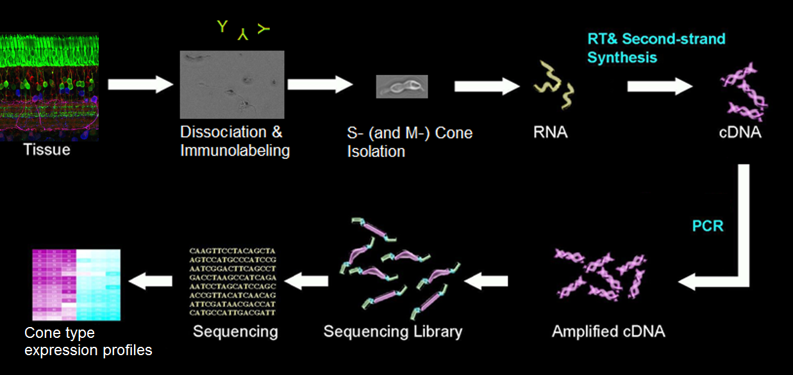
Single Cell RNA Sequencing Workflow

Slide 6
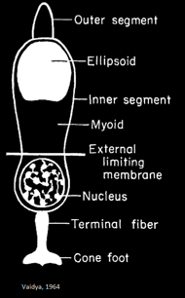
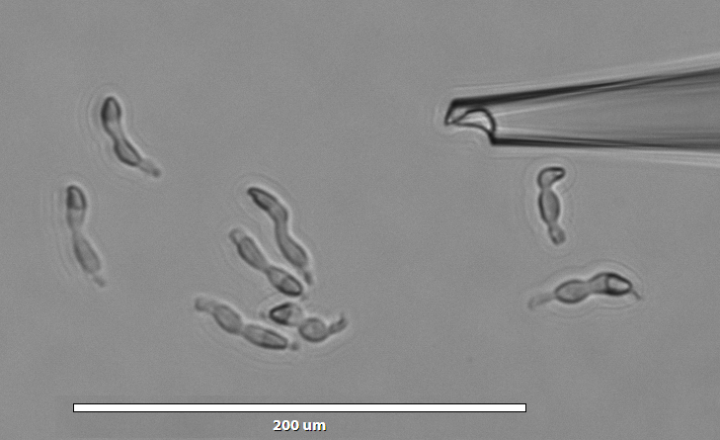
Cone Morphology after Dissociation

Slide 7
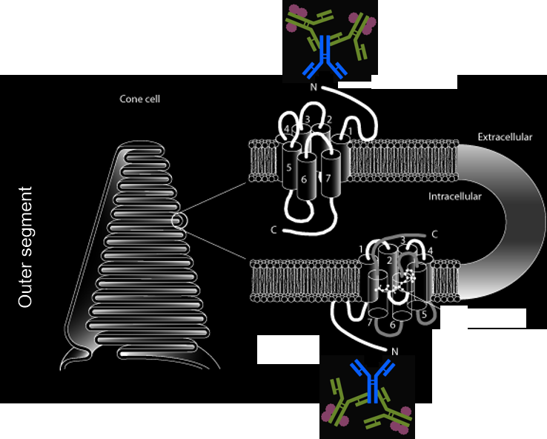
Live Labeling of Photoreceptors
Retina preparation
Antibody labeling (S-opsin)
Dissociation
Cell Picking
Outer segment
Outer segment: CVRL.org
Antibody complex: Thermo Fisher

Slide 8
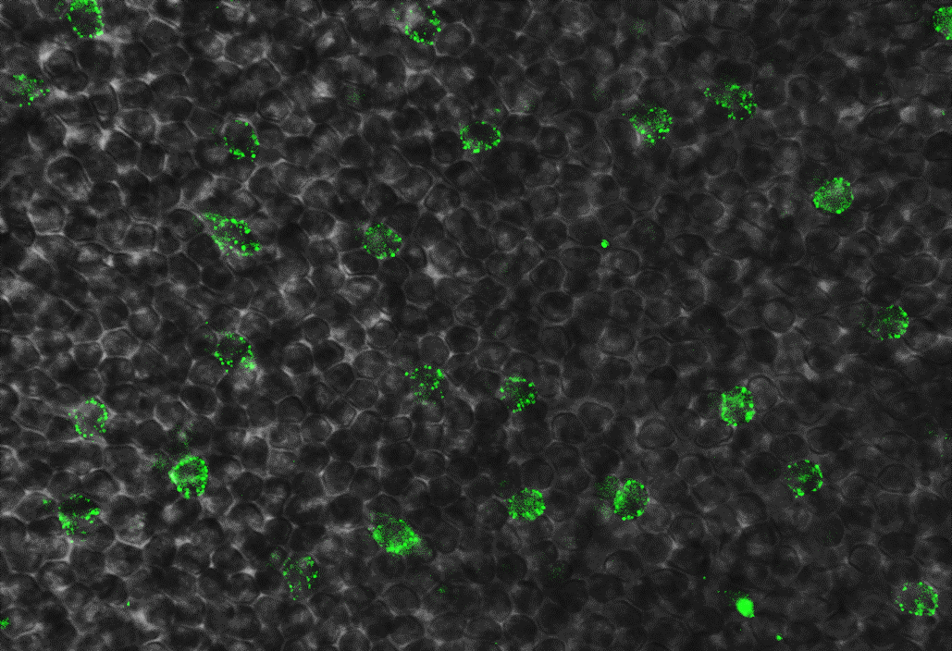
Live Labeling of Photoreceptors
Ground squirrel retina, whole mount
S-Opsin

Slide 9
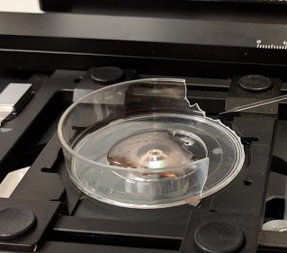
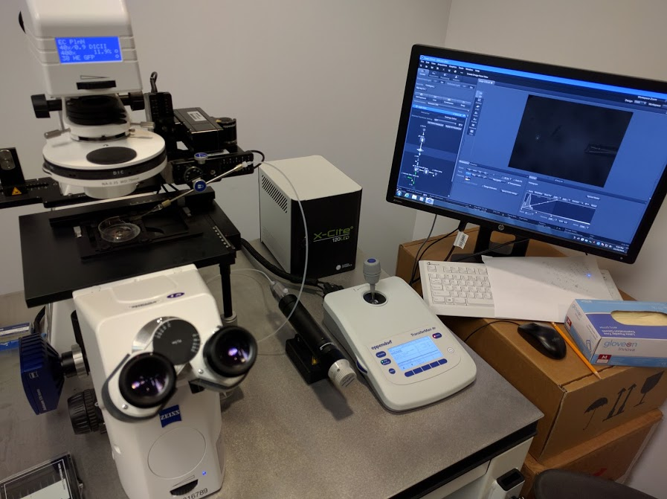
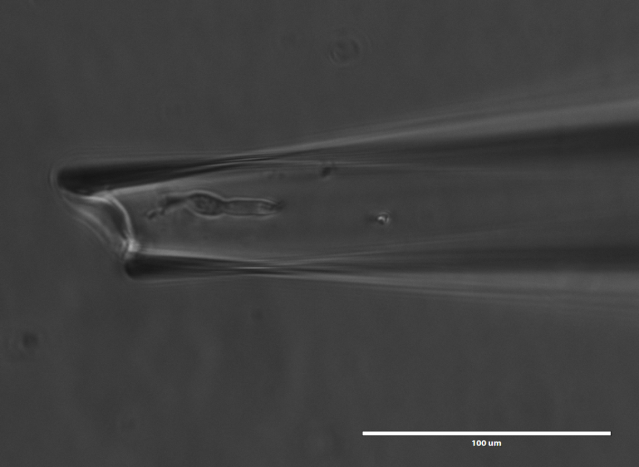
Picking Single Cells

Slide 10
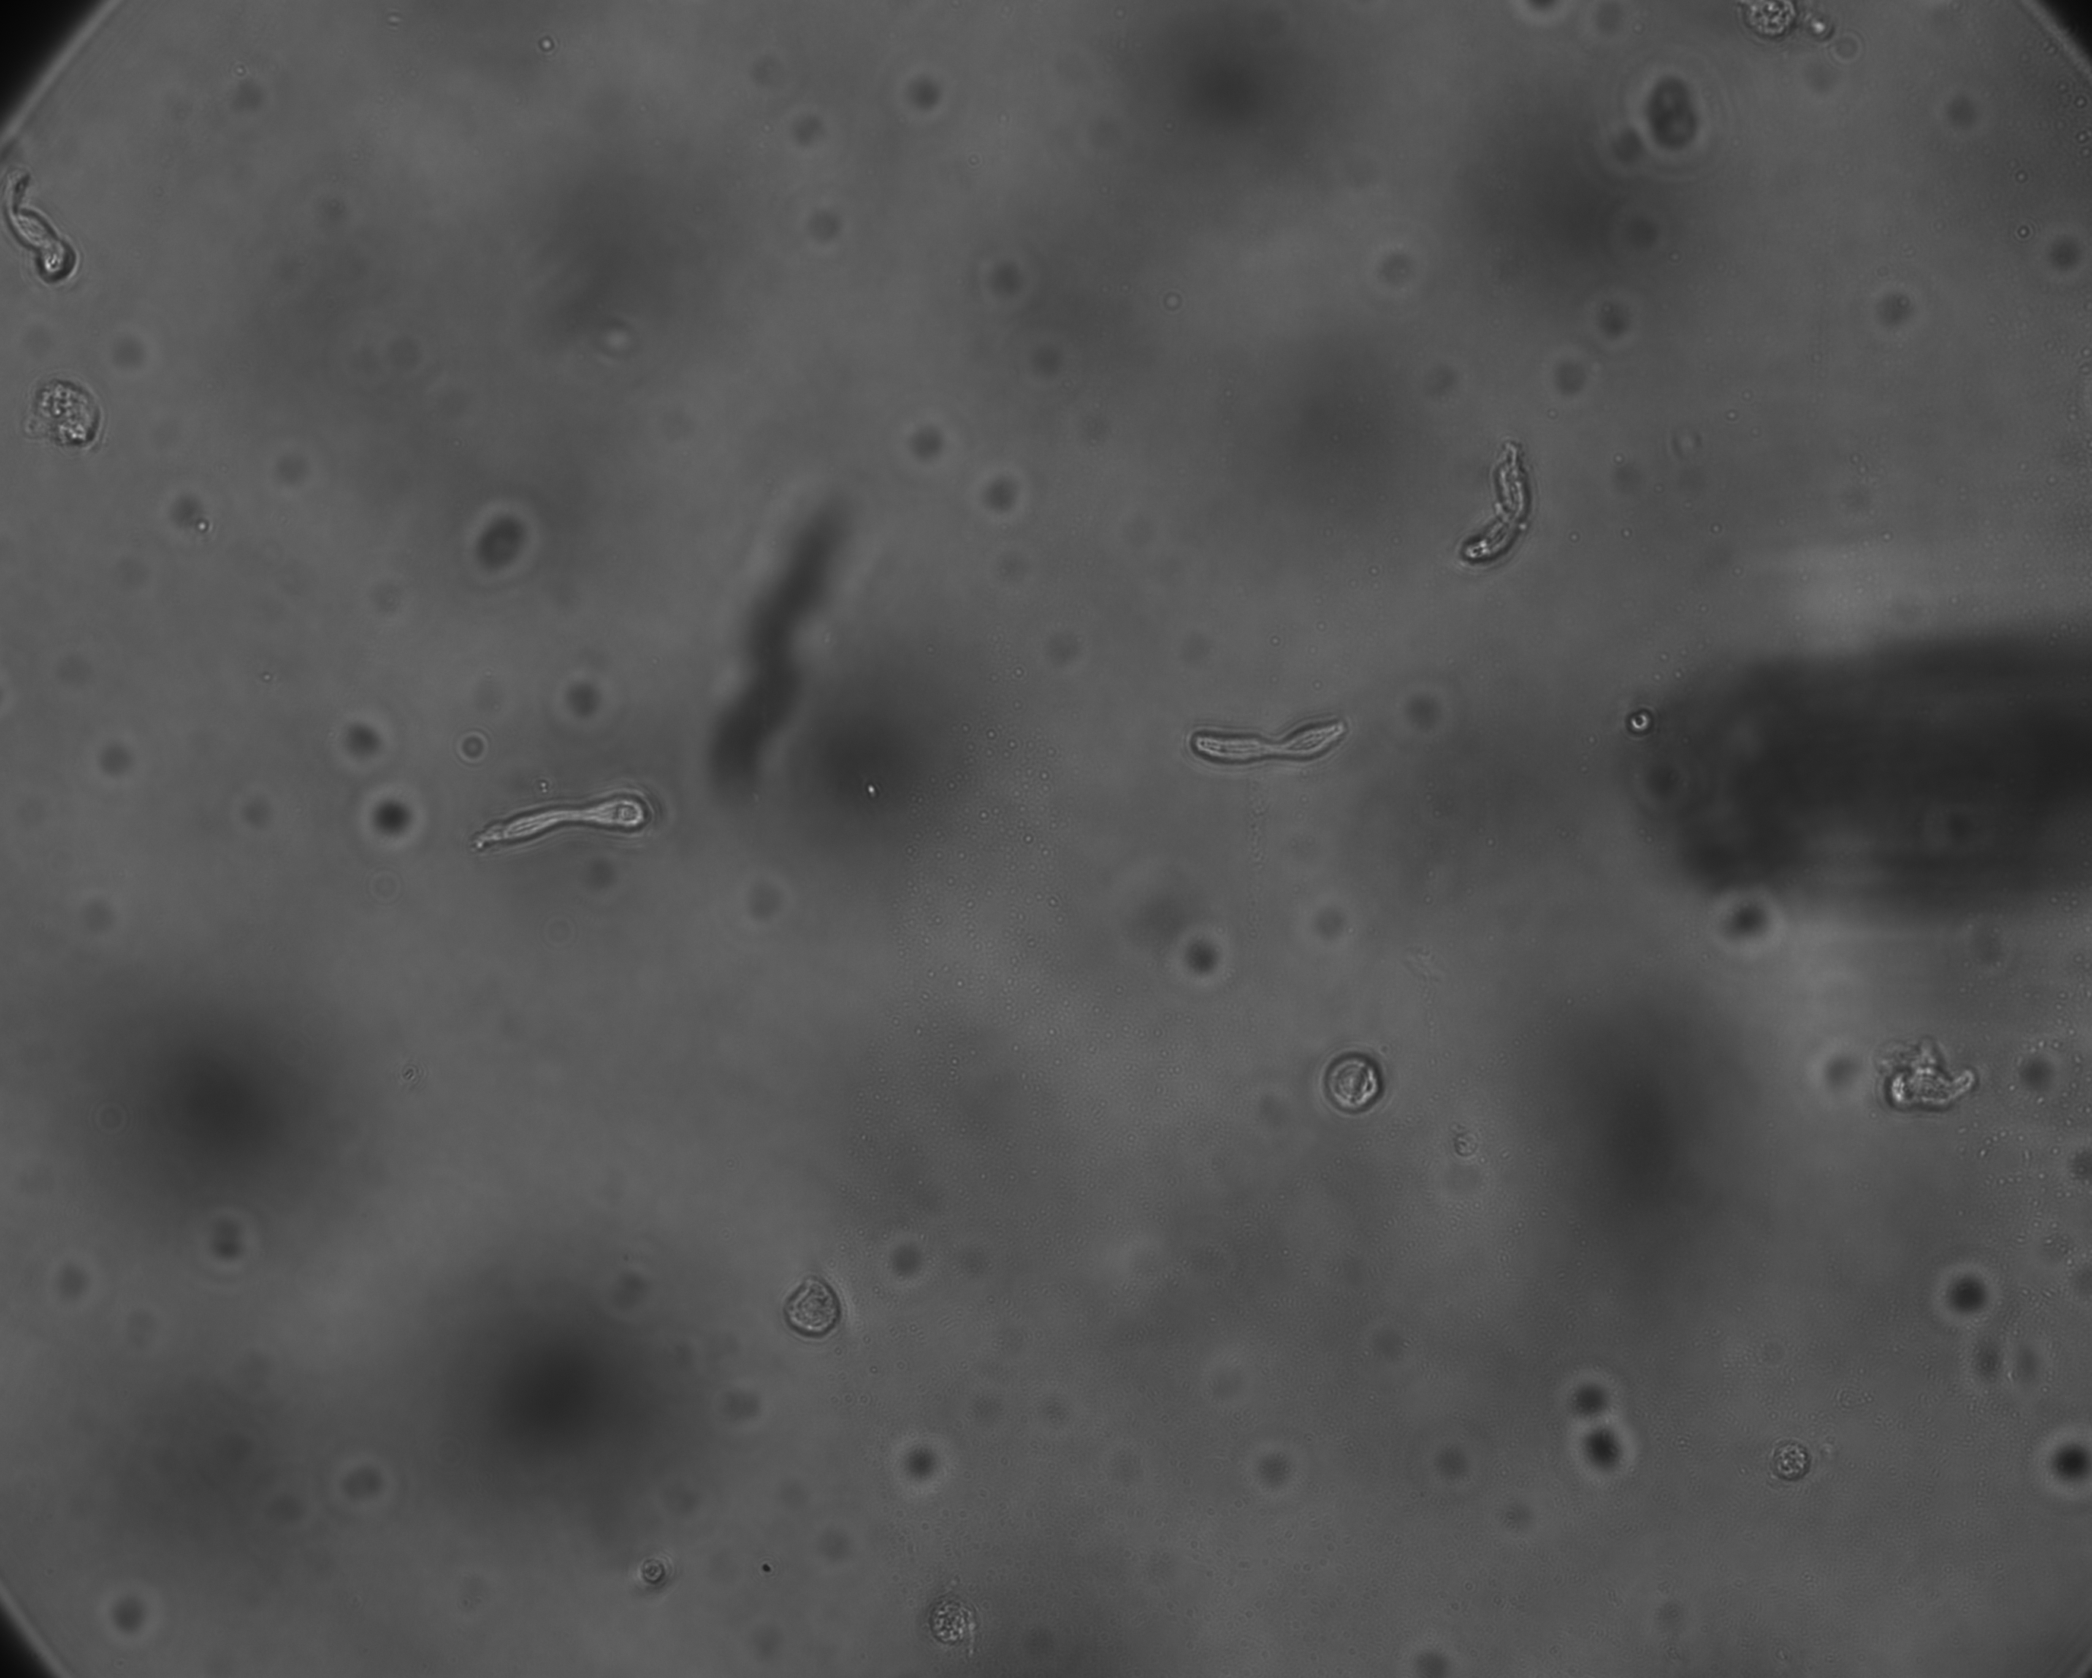

Slide 11
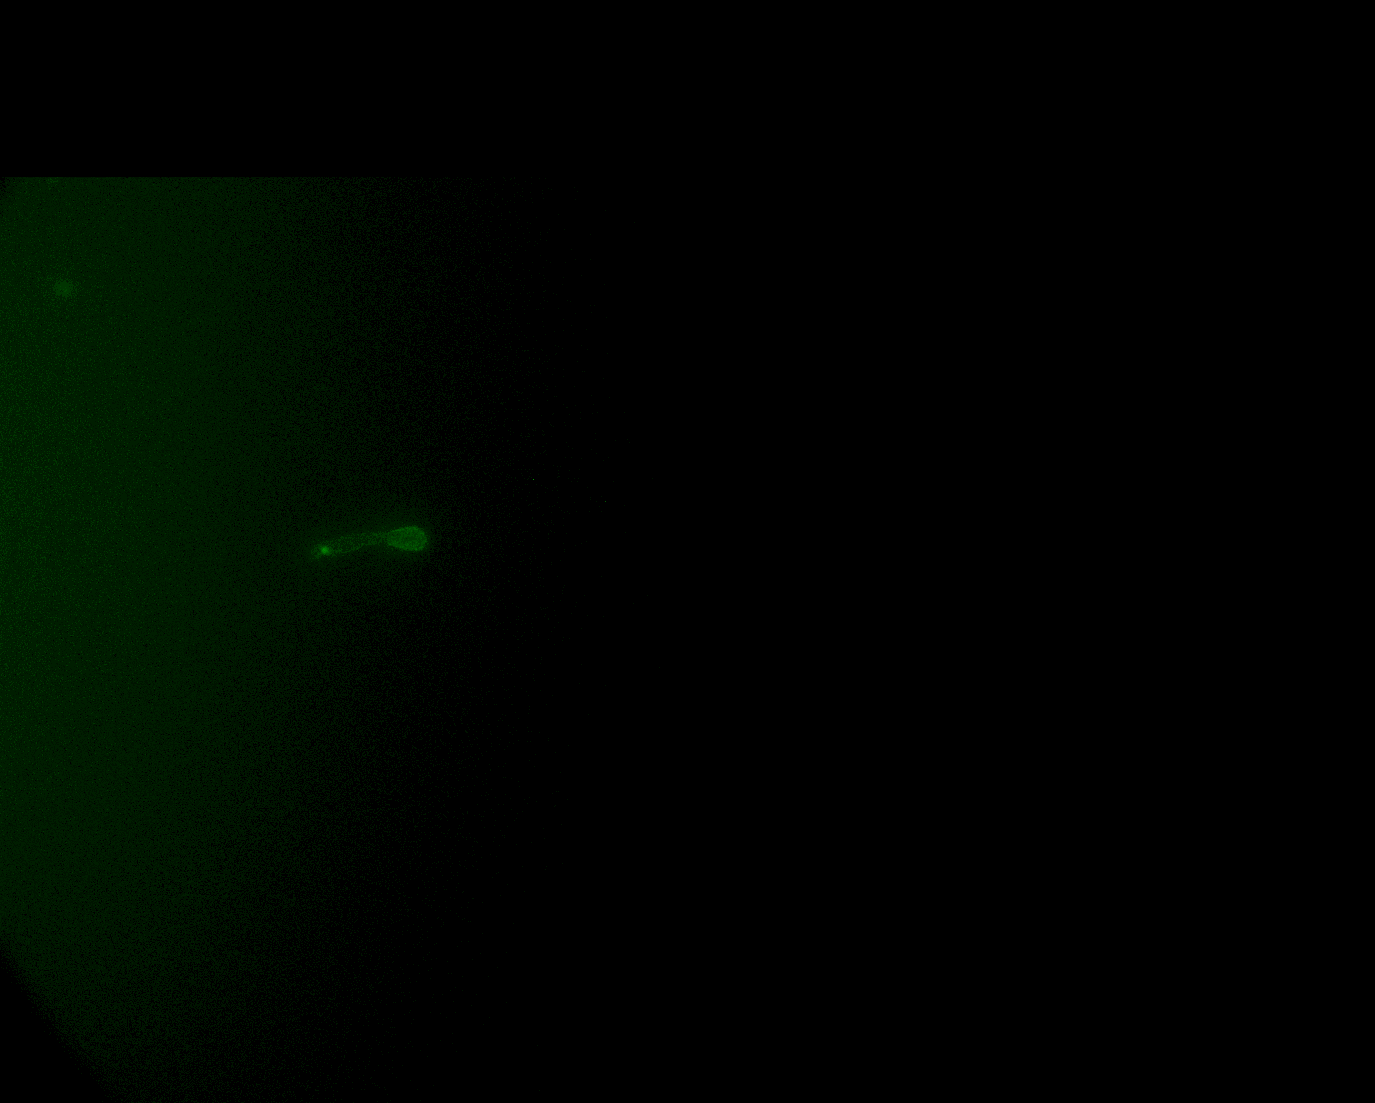

Slide 12
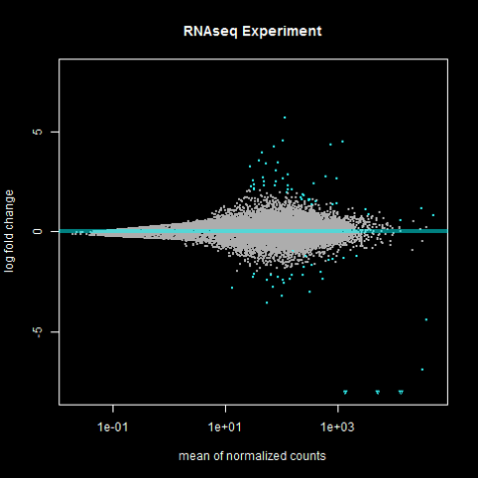
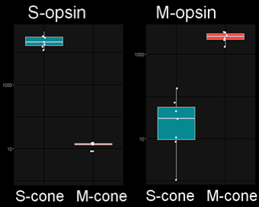
RNA Sequencing Results
M-opsin
log fold change
Normalized counts - log10 scale
S-opsin
mean of normalized counts

Slide 13
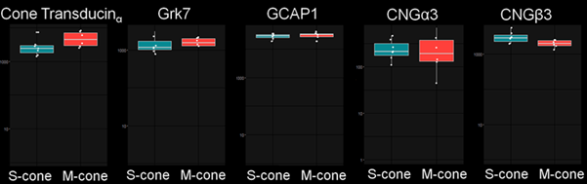
Most Phototransduction Genes in S- and M-Cones are Equally Expressed
Normalized counts - log10 scale

Slide 14
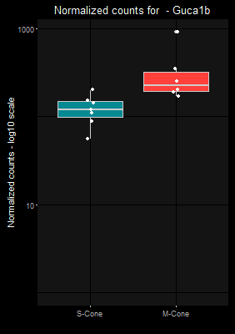
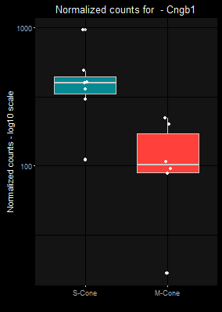
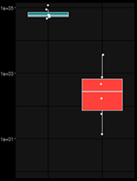
Other Differentially Expressed Phototransduction Genes
GCAP2 CNGβ1 Rod-arrestin
Normalized counts - log10 scale

Slide 15
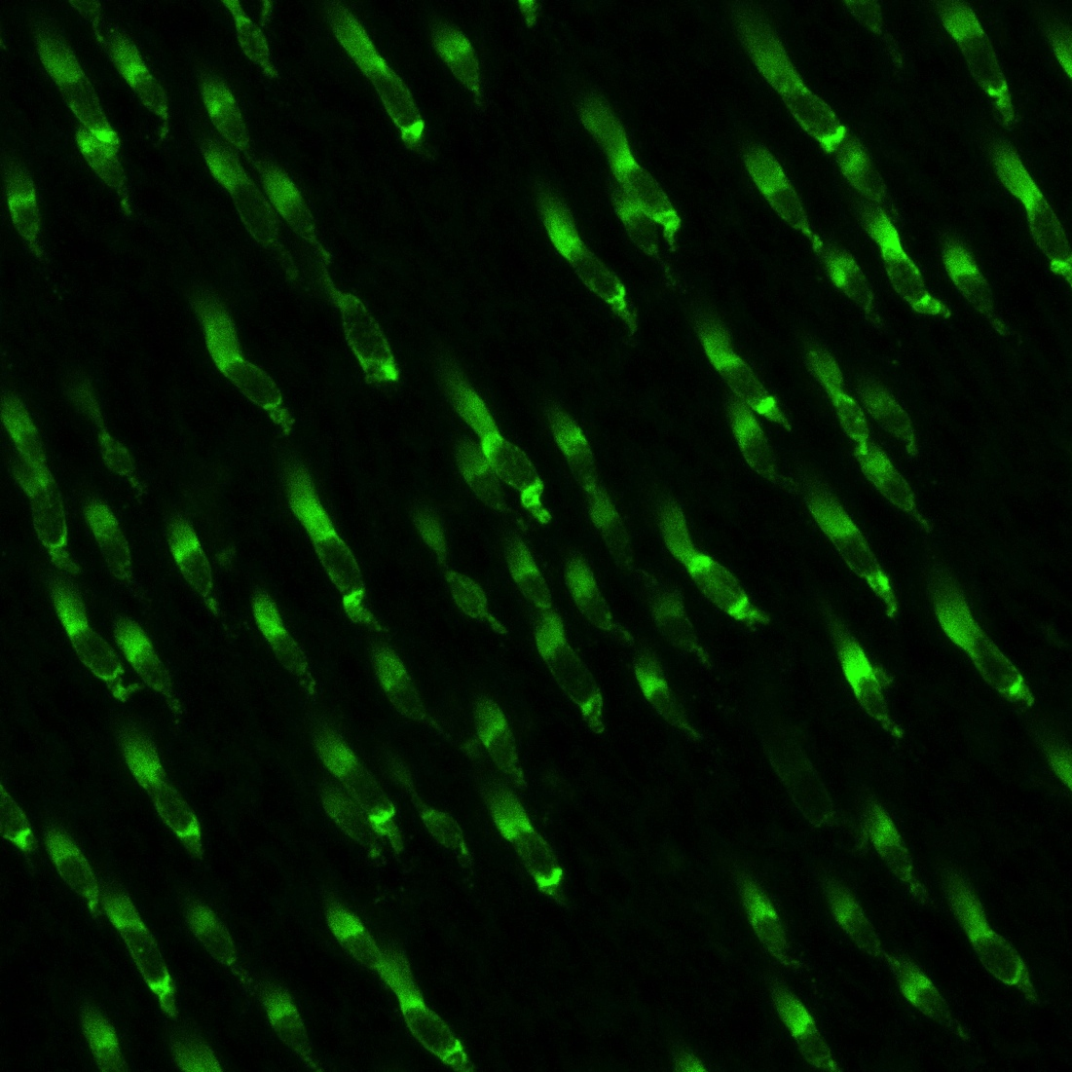
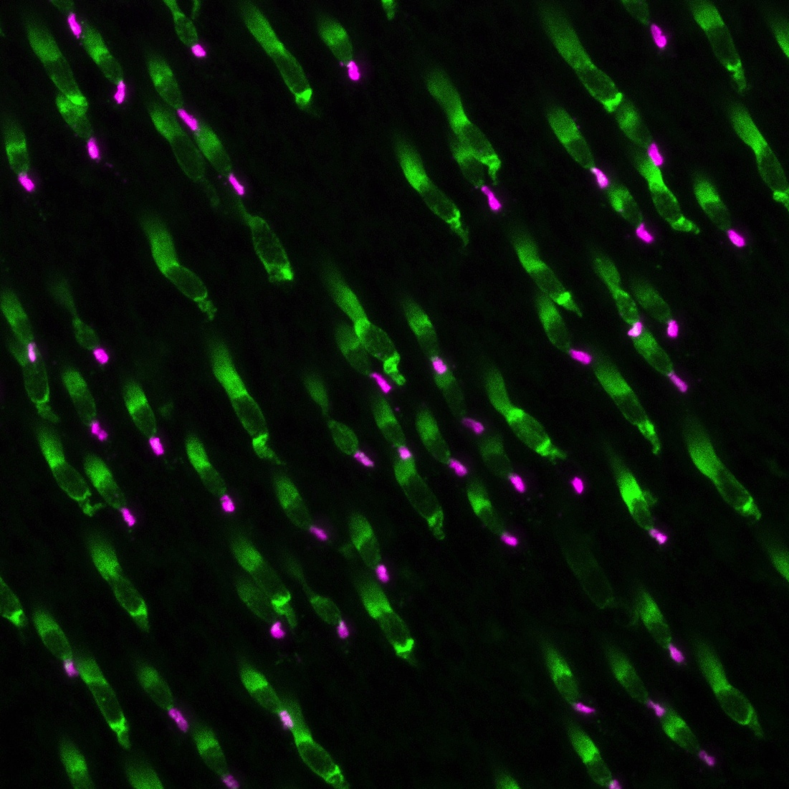
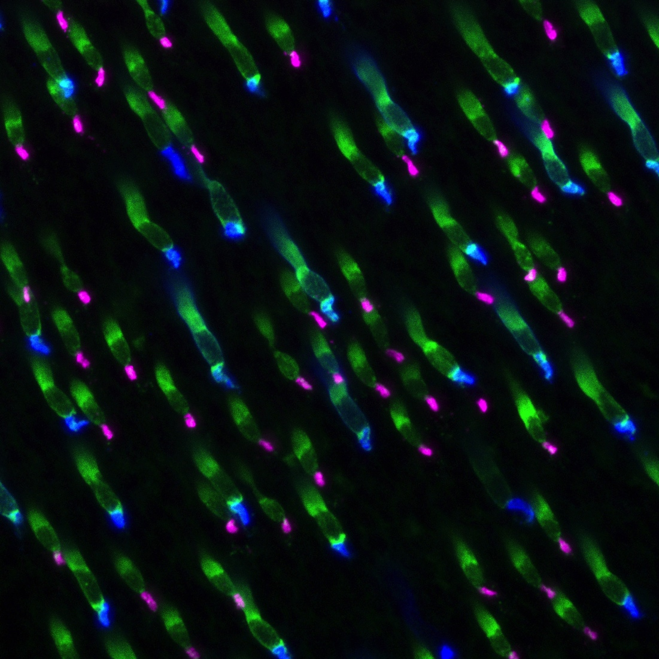
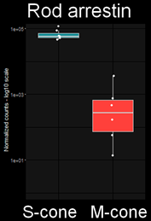
Rod-Arrestin is expressed in S-cones and Rods (Ground Squirrel)
Rod arrestin (
Normalized counts - log10 scale
Rhodopsin
S-opsin

Slide 16
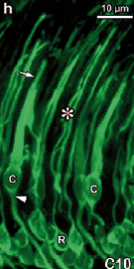
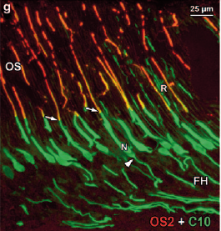
Rod-Arrestin is Expressed in Primate S-cones
Macaque
Rod arrestin in Cones and Rods
Marmoset
Rod arrestin, S-opsin
Craft et al., 2014

Slide 17
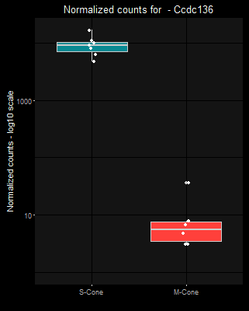
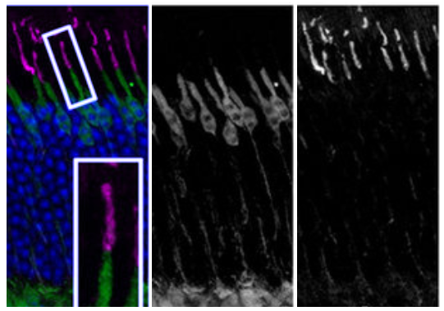
Ccdc136 is a new marker for S-opsin expressing cones
Ccdc136
Ccdc136-GFP +/+ mouse retina, ventral
OS
IS
ONL
OPL
Normalized counts - log10 scale
Ccdc136-GFP
S-opsin
Ccdc136-GFP
S-opsin
Smiley et al., 2016

Slide 18
Summary I
Immunolabeling live cells is a powerful tool
Most phototransduction genes and known markers are expressed as expected in the respective cone type which proves the quality of the collected data
A positive immunosignal for rod-arrestin in S-cones, and recent data about Ccdc136 confirm the ability of our data to predict differentially expressed genes in cones
We hope further screening of the genes we identified will reveal more differences between cone types
Synapse formation?

Slide 19
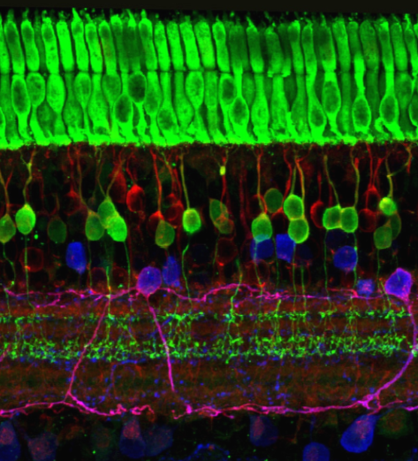
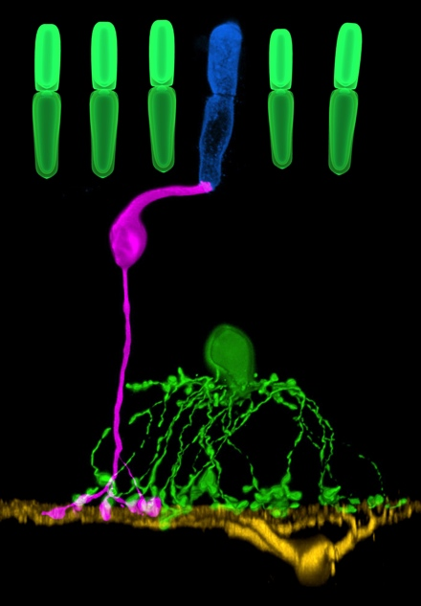
S-cone
S-cone bipolar cell
How does an S-cone bipolar cell find an S-cone?
Notes:
General Difference S/M
S-Cone is rare but specific cells connect to it (S-cone BC). How?

Slide 20
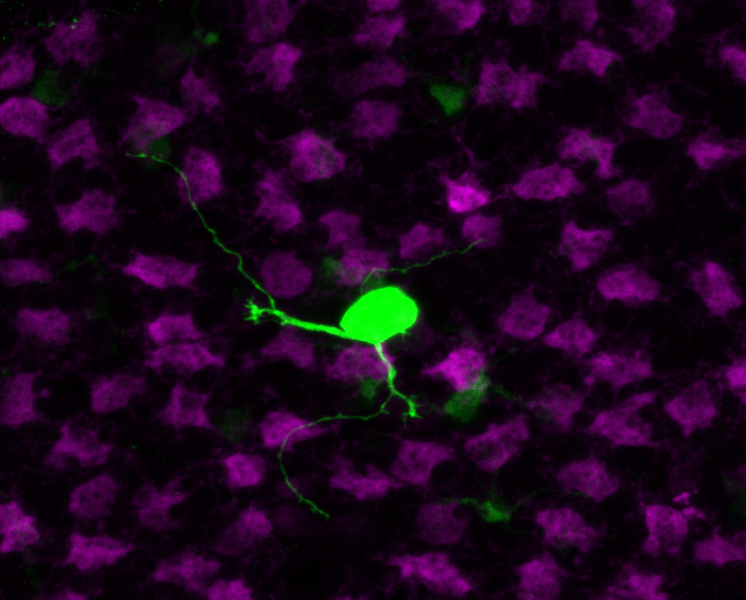
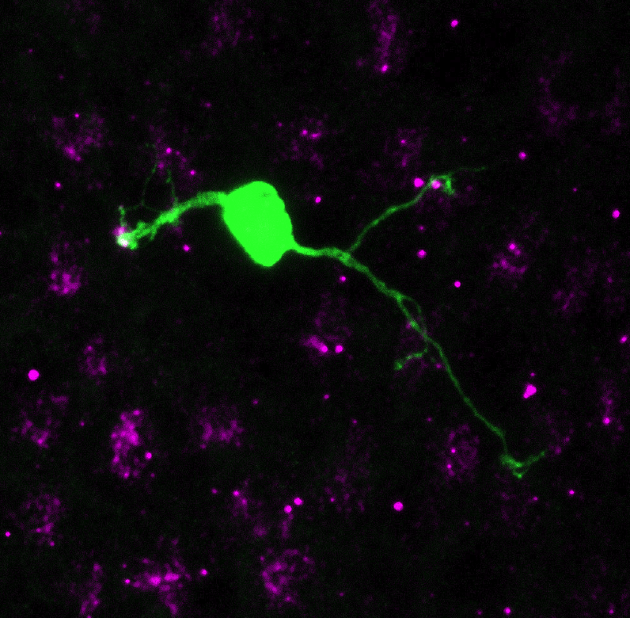
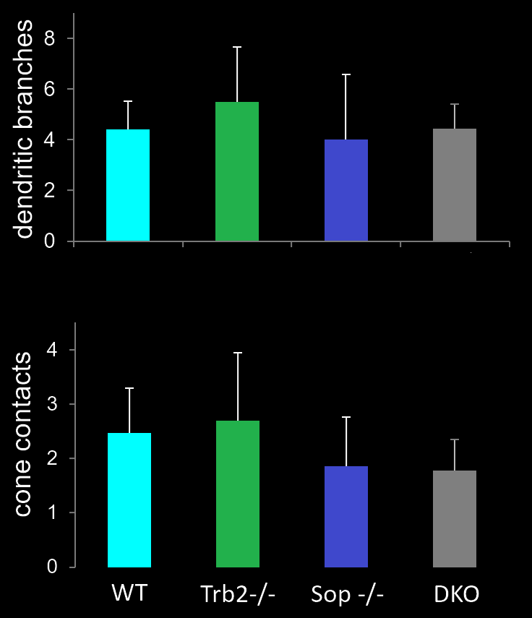
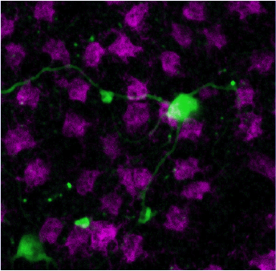
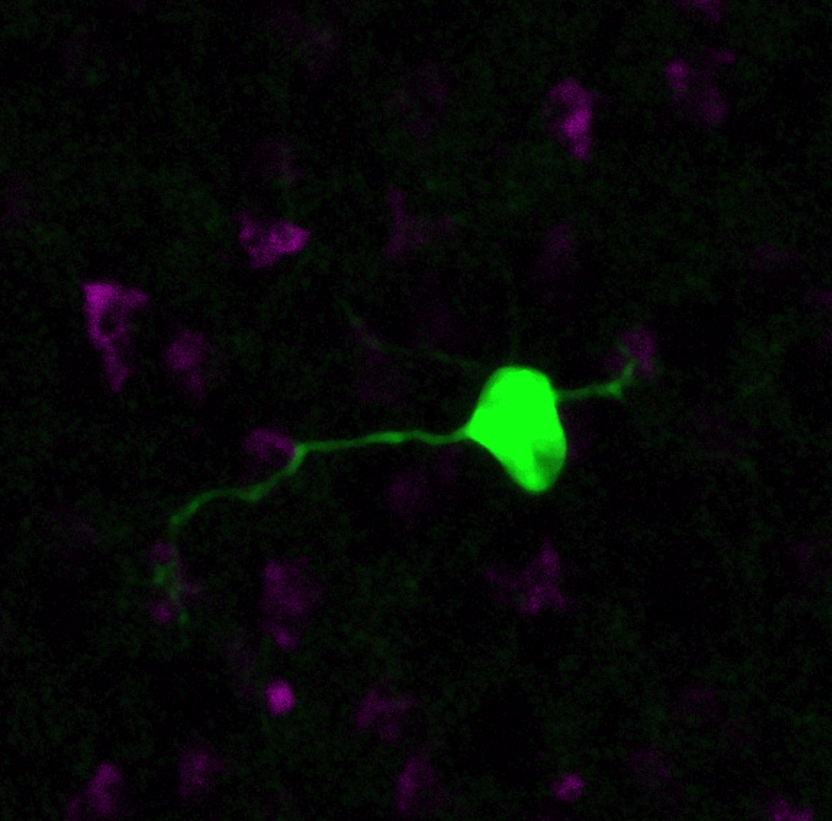
S-Cone Bipolar Cells in Mice Form Specific S-Cone Synapses Regardless of the Expressed Opsin
Trβ2-/-: No M-opsin, instead S-opsin
Sop-/-: No S-opsin
WT
Trβ2-/-
Sop-/-
DKO
Green: S cone bipolar cells (Clomeleon-GFP)
Magenta: Cone pedicles
(Anti-cone arrestin)
Li Jia
Clomeleon in S-cone bipolar cells: Haverkamp et al., 2005
Notes:
Express S-opsin. No M. Haverkamp. Pedicles

Slide 21
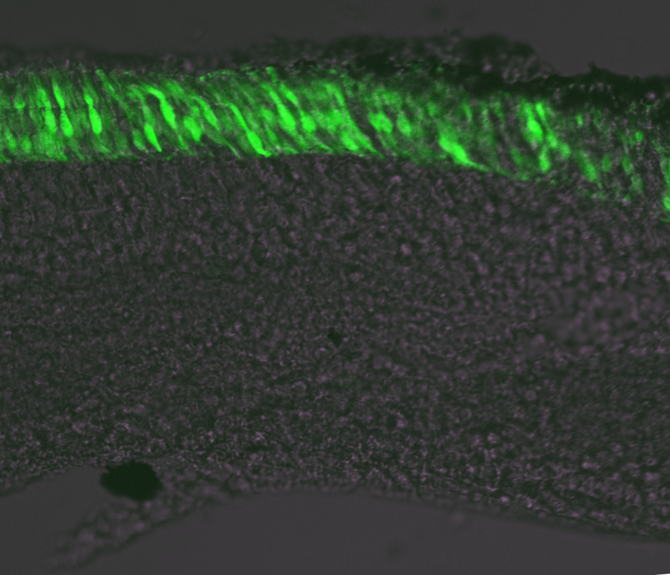
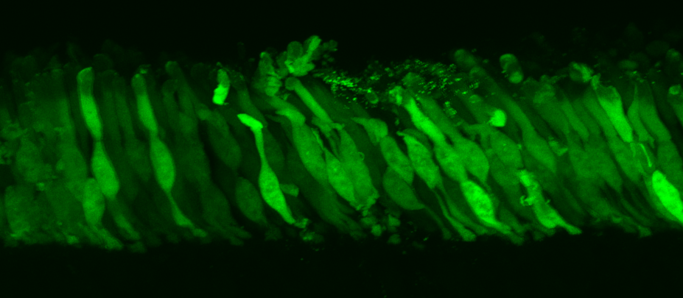
Future Directions
? ?
? ?
? ?
? ?
AAV mediated GFP expression in the ground squirrel
Verify results (ISH, IHC), explore more genes
Functional studies (AAV + CRISPR/Cas9)

Slide 22
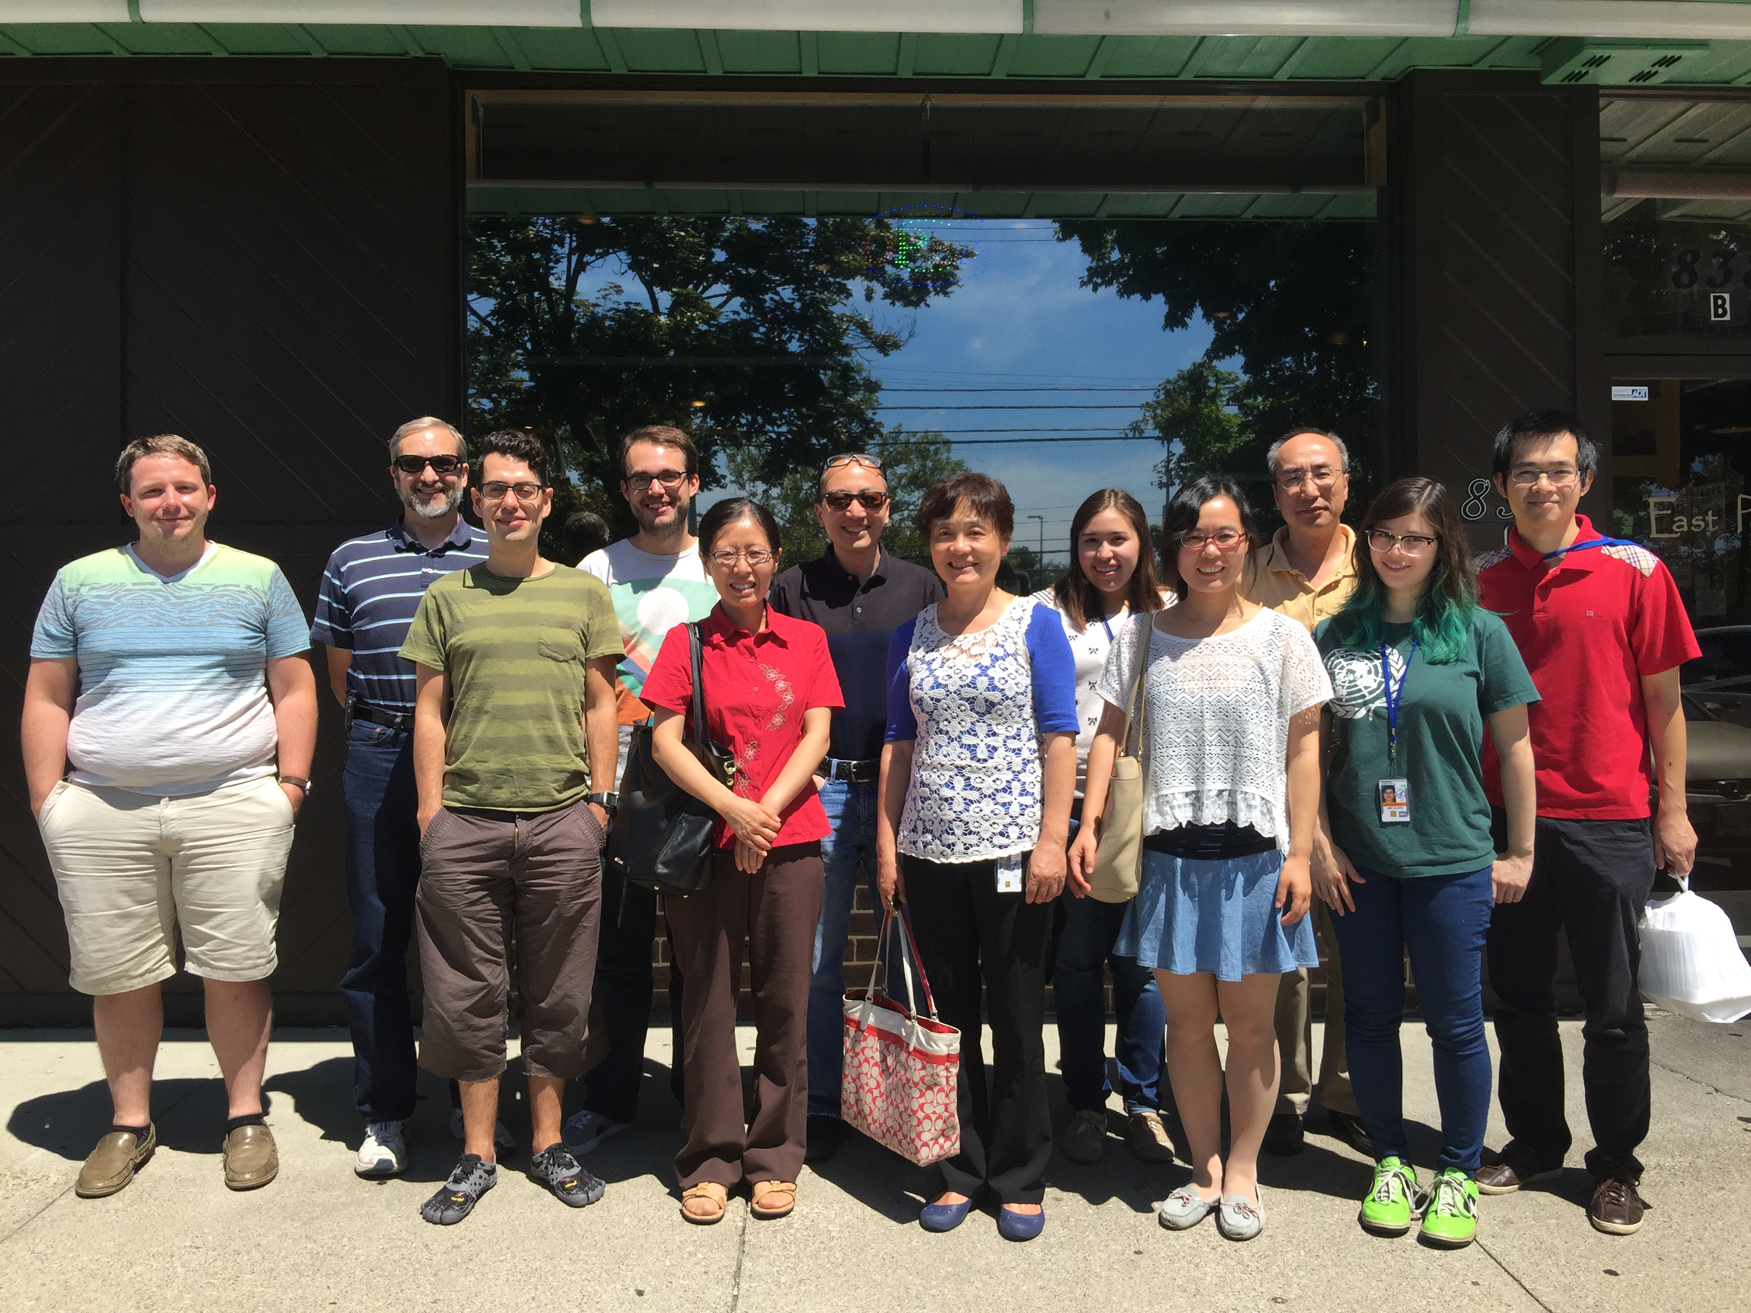
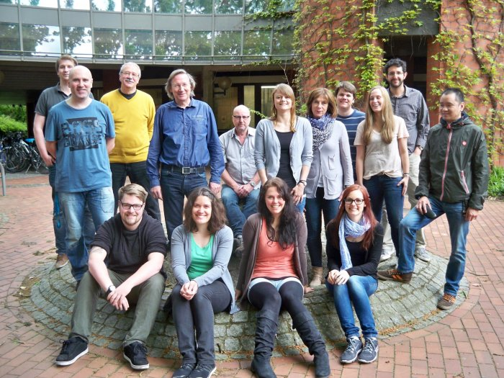


Retinal Neurophysiology Section NEI/NIH
Wei Li
Fengyu Qiao
Jingxing Ou
John Ball
Joshua Miyagishima
Juan Angueyra
Li Jia
Tantai Zhao
Shan Chen
Nuclear Receptor Biology Section, NIDDK/NIH
Douglas Forrest
Hong Liu
Xuefeng Wu
Carl von Ossietzky Universität Oldenburg
Karl-W. Koch
Christian Puller

Slide 23
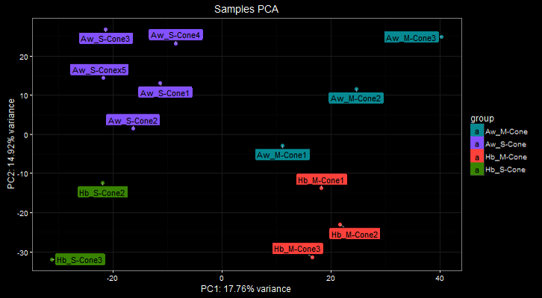
RNA Sequencing Results

Slide 24
Rod Genes
 |  |  | Mean counts
Gene |  |  | S-cones | M-cones
Cone transducin |  |  | 2953 | 5057
Rod transducin |  |  | 0 | 0.1
S-opsin |  |  | 24219 | 10
M-opsin |  |  | 45 | 2606
Rhodopsin |  |  | 117 | 137
Receptor kinase 7 |  |  | 1543 | 1644
Rhodopsin kinase |  |  | 0 | 0

Slide 25
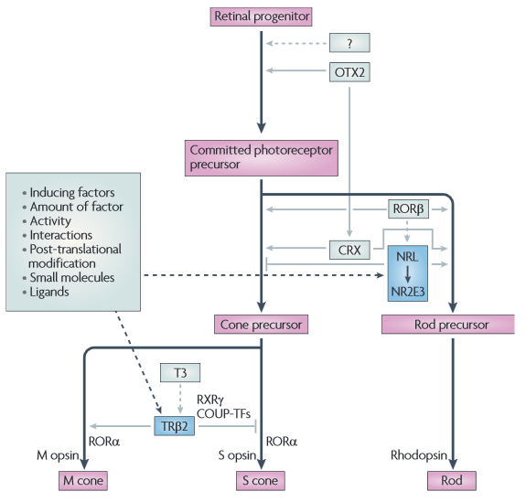
Photoreceptor Cell Fate Determination
Swaroop et al., 2010

Slide 26
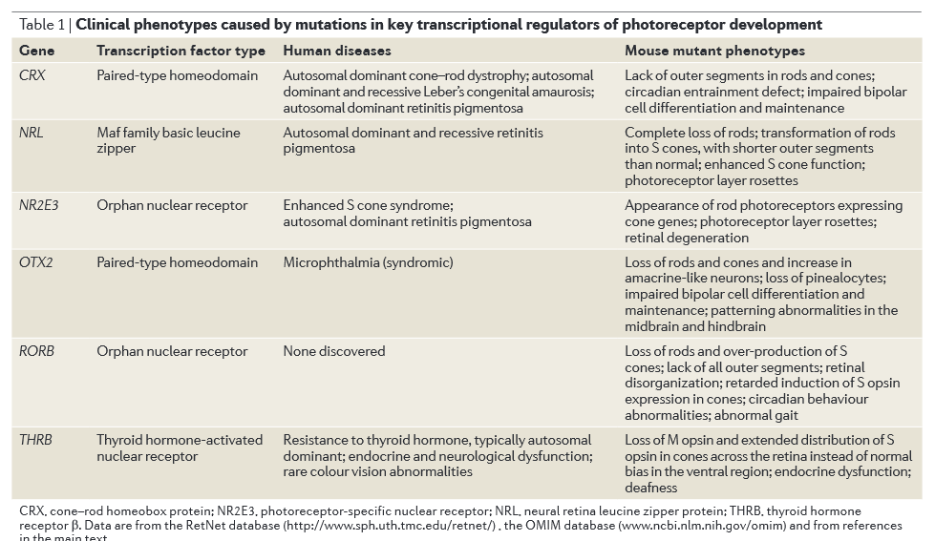

Slide 27
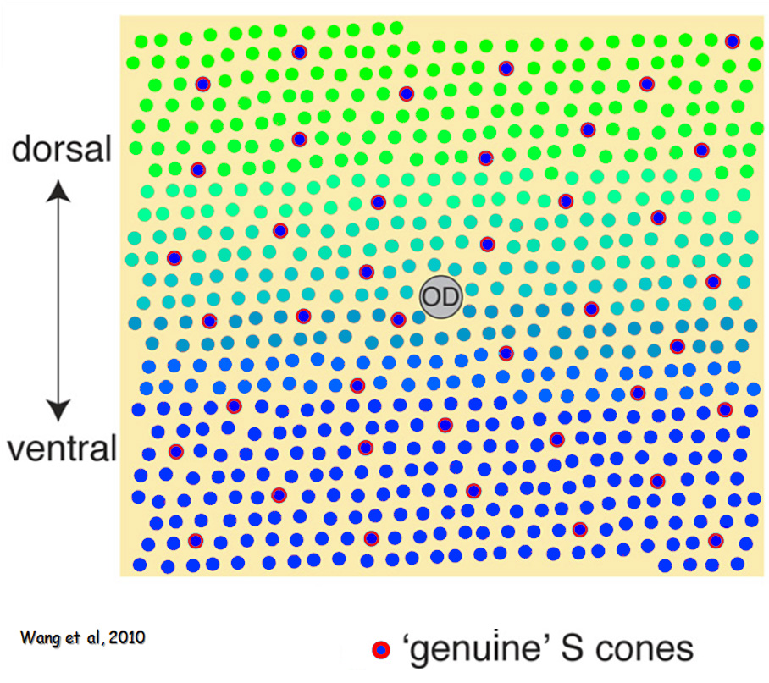
Most Mouse Cones Co-express S- and M-opsin
Applebury et al., 2000

Slide 28
pre-
pre-
post-
How does a postsynaptic neuron find the proper presynaptic target?

